Slide 1
Interoperability
Overview and use of IFC
Jan Karlshøj
Associate Professor
jak@byg.dtu.dk

Slide 2
Agenda
13:00 – 13:30 The Problem
13:30 – 13:40 Break
13:40 – 14:20 The Principles
14:20 - 14:30 Break
14:30 – 15:00 Samples
15:00 - Exercise

Slide 3

The Problem
Exchange of information

Slide 4

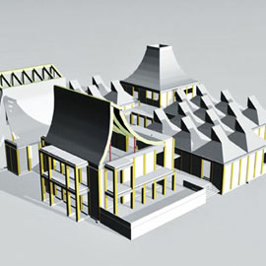
The Problem
From drafting to modelling

Slide 5

The Problem
From individuals to teamwork

Slide 6
The Problem
From all-round knowledge to specialist

Slide 7
The Problem
From isolated tools to integrated tools

Slide 8
The Problem
From national view to international view

Slide 9
The Problem
Solutions
  One vendor
  Interfaces/several vendors

Slide 10
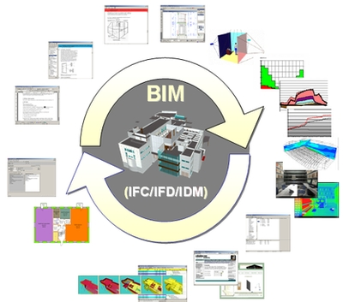
The Problem
Preferred solution
From Sintef

Slide 11
The Principles
Real world concepts
  Physical
    Building
    Wall
    Column
    Boiler
    Valve
  Organisation
    Company
    Actor
  Processes
  Control

Slide 12
The Principles
Wall
  Identification
  Geometry
  Properties
  Relationship to other elements
  Relationship to spatial structure

Slide 13
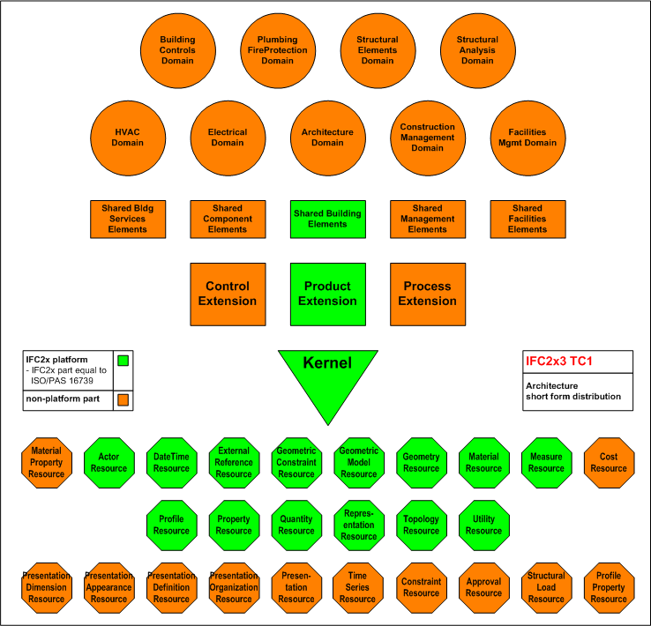
The Principles
  Industry Foundation Classes (IFC)
  http://www.iai-tech.org/products/ifc_specification/ifc-releases

Slide 14
The Principles
  Industry Foundation Classes (IFC)
Object
Property set
Object
Property set
Property set
Object
Property set
Building
Property set
eg.
Fire rating
Acoustic rating
Wall
Property set
eg.
Fire rating
Acoustic rating
Cost
Relation

Slide 15


The Principles
Information Delivery Manual (IDM)
Certification
Model View Definition (MVD)
Software development
Industry Foundation Classes (IFC)

Slide 16
Information Delivery Manual (IDM)
Information Delivery Manual (IDM)
Information Delivery Manual (IDM)
Model View Definition (MVD)
Model View Definition (MVD)
Model View Definition (MVD)
Certification
Certification
Certification
Industry Foundation Classes (IFC)

Slide 17
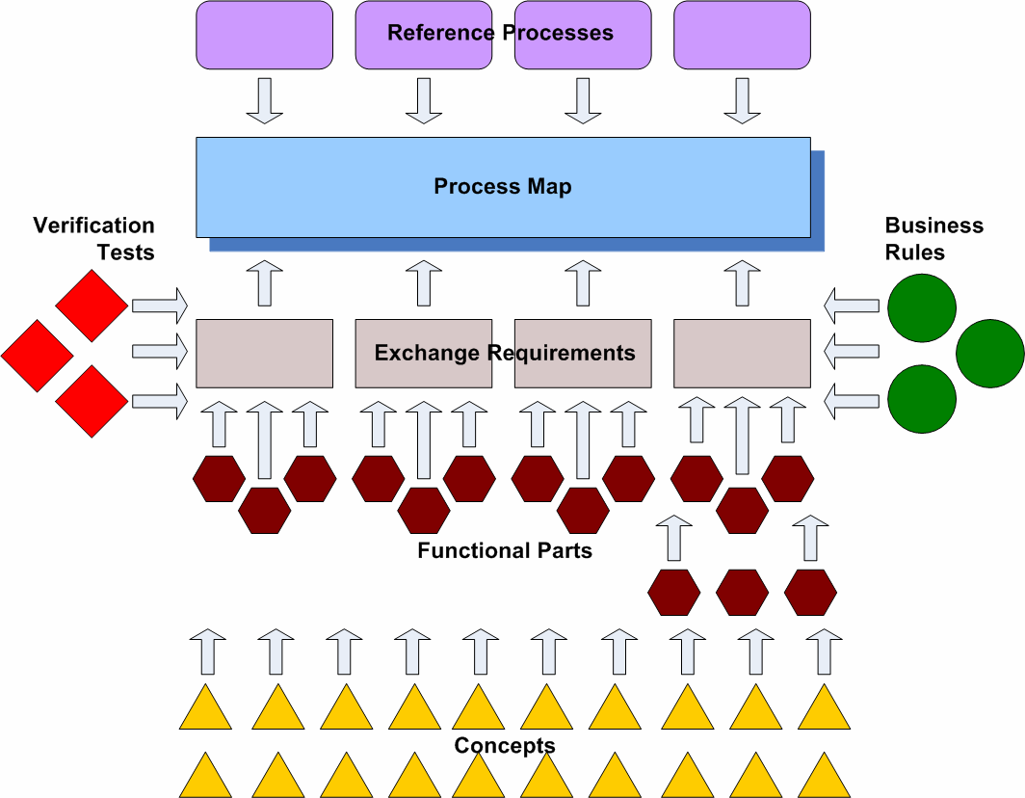
The Principles
  Information Delivery Manuals (IDM) http://idm.buildingsmart.no/confluence/display/IDM/Home

Slide 18
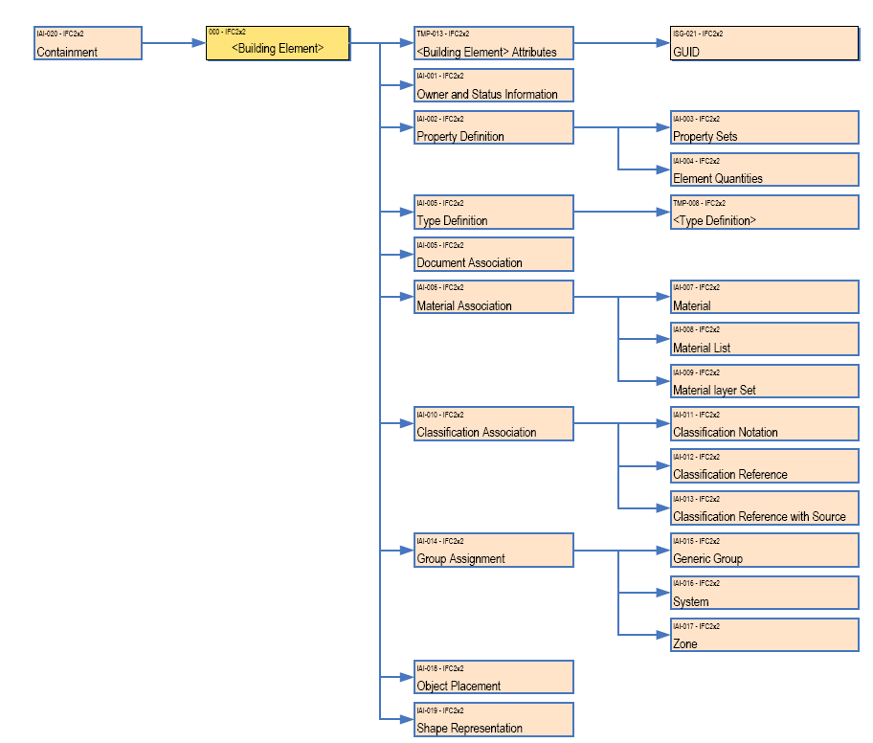
The Principles
  Model View Definitions (MVD)
  http://www.blis-project.org/IAI-MVD/

Slide 19



The Principles
Software Certification
http://www.iai.hm.edu/how-to-implement-ifc/certification

Slide 20

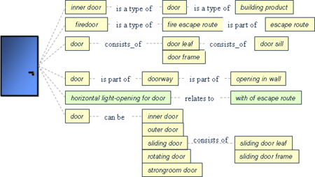
The Principles
  International Framework for Dictionaries (IFD)
  http://www.ifd-library.org/index.php/Main_Page
GUID: 3vHRQ8oT0Hsm00051Mm008

Slide 21
The Principles
Links
  Information Delivery Manuals (IDM) http://idm.buildingsmart.no/confluence/display/IDM/Home
  Model View Definitions (MVD)
  http://www.blis-project.org/IAI-MVD/
  Industry Foundation Classes (IFC)
  http://www.iai-tech.org/products/ifc_specification/ifc-releases
  International Framework for Dictionaries (IFD)
  http://www.ifd-library.org/index.php/Main_Page
  Software Certification
  http://www.iai.hm.edu/how-to-implement-ifc/certification

Slide 22
Break

Slide 23
Samples
An wall
  CAD/BIM
  Viewer
  Excel
bips Live BIM event
http://bipslivebim.wordpress.com/
Rambøll Head Quarters

Slide 24
Challenges
User
Receiving user’s needs
Software
Extract data
Modelling
Import IFC
(mapping from IFC)
Export IFC
(mapping to IFC)

Slide 25
Break

Slide 26
Exercise
#1 | Create some building elements in ADT or Revit. Export the elements to IFC. Import the elements into Excel, Solibri, and Revit.
#2 | Look into the structure of IFC 2x3 TC1 specification. Which structure is IfcSpaces a part of? Which structure is IfcBeam a part of?
#3 | Specify four technical properties from four elements from the HVAC and electrical domains. Please include a reference to the property sets that they belongs to
#4 | Specify the purpose of: Information Delivery Manuals (IDM) Model View Definitions (MVD) Industry Foundation Classes (IFC) International Framework for Dictionaries (IFC) Software Certification
#5 | If an error occurs during an IFC based information exchange, please specify the reasons for why that could happen.

Slide 27
Install
Install software from Campusnet under Interoperability
Path to license file licens-3/student.byg.dtu.dk
Use Solibri as a Viewer

